Slide 1
Session 7
Arrays
and
Pointers

Slide 2
Session Objectives
Discuss and use pointers
Identify single dimension arrays
Defining an array
Initializing of an array
Character arrays
Identify multidimensional arrays
Initializing 2-D arrays
Explain 2-D character arrays

Slide 3
Accessing Variables
Values of variables can be accessed
Referring to the variable name
Referring to the memory address of its location
Memory addresses are numeric addresses,
in the RAM, that are assigned to variables

Slide 4
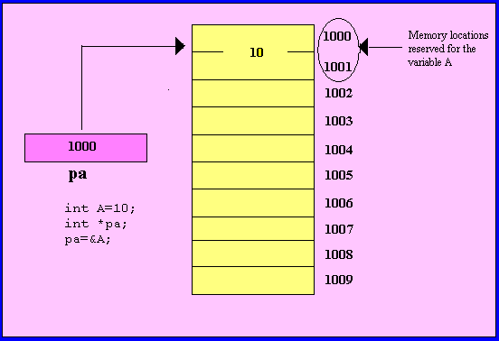
Pointers (1)
A variable which holds an address
Defined using the ‘ * ‘ operator

Slide 5
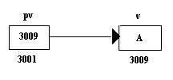
Pointers (2)
char v, *pv
v = 'A' ;
pv = &v ;

Slide 6
lvalues and rvalues
lvalue (left value) -
Address where the variable is stored in memory
rvalue (right value) -
Is the content stored at the lvalue memory address

Slide 7
Pointer fundamentals (1)
Data is stored in
contiguous memory cells
The number of memory cells required to store a
data item depends on the type of data item
Character - 1 byte
Integer - 2 bytes
Floating - 4 bytes
Double - 8 bytes

Slide 8
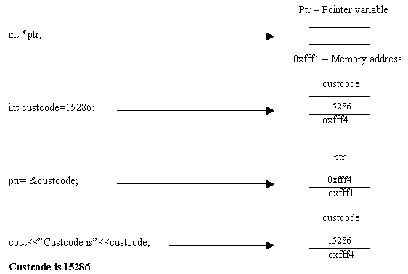
Pointer fundamentals (2)

Slide 9
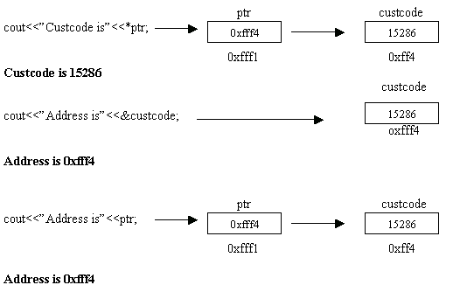
Pointer fundamentals (3)

Slide 10
Call by value
When data is passed between functions using variable names
void main(void)
{
int data ;
:
:
call_function(data) ;
}
void call_function(int data)
{
cout << data ;
}

Slide 11
Call by reference
When data is passed between functions using address of variables
void main(void)
{
int data ;
:
:
call_function(&data) ;
}
void call_function(int *p_data)
{
cout << *p_data ;
}

Slide 12
Value modification (1)
void main(void)
{
int u = 1; int v = 3;
:
funct1(u, v);
:
funct2(&u,&v); /* addresses of u and v are passed */
}

Slide 13
Value modification (2)
void funct1(int u, int v)
{
u = 0; v = 0;
}
void funct2(int *pu, int *pv)
{
*pu = 0 ; *pv = 0 ;
}

Slide 14
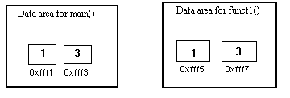
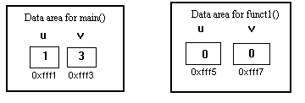
Value modification (3)
When funct1()
is called
Inside funct1()

Slide 15
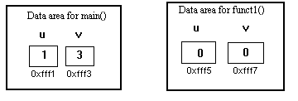
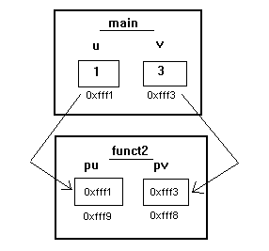
Value modification (4)
Back to main
When funct2()
is called

Slide 16
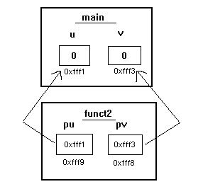
Value modification (5)
When funct2() is
executed

Slide 17
Arrays
Group of elements storing a common type of data
number[0]
Elements differentiated by their positions
in the array
number[1]
int number[5] ;
number[2]
number[3]
number[4]
Type specifier
size
Variable name

Slide 18
Initialization of an Array
number[0] = 35;
number[1] = 40;
number[2] = 20;
number[3] =57;
number[4] = 19;
int digits[4] = {3,78,17,10};
float x[4] = {-89.7,0,29.34,-2.0};

Slide 19
Character Arrays (1)
Generally used to represent a string
n character string will occupy n + 1 array locations
The null character ‘ \0’ is automatically placed
at the end of the string

Slide 20

Character Arrays (2)
# include <iostream.h>
void main(void)
{
char name[10];
cout << "\nEnter your first name: " ;
cin >> name ;
cout << endl ;
cout << “\nHello " << name << ". Welcome to Arrays!” ;
}
Enter your first name: SARAH
Hello SARAH Welcome to Arrays!

Slide 21
Using gets() with Arrays
The gets() function can be used to input string
to a character array
char str_char[100] ;
cout << "Enter a string\n" ;
gets(str_char) ;// Receiving input
// from the keyboard

Slide 22
Multidimensional Arrays (1)
data_type array_name[expression 1][expression 2]…[expression n] ;
Defining 2 dimensional array
int arr_1[3][3] ;
0
1
2
1
2

Slide 23
Multidimensional Arrays (2)
#include <iostream.h>
#include <conio.h>
void main(void)
{
int i, j, matrix[3][4] ;
clrscr() ;
for(i=0; i<3; i++)
{
cout << "Enter numbers for row " << (i+1) << endl ;
for(j=0; j<4; j++)
{
cin >> matrix[i][j] ;
}
}

Slide 24
Multidimensional Arrays (3)
cout << "You entered... " ;
for(i=0; i<3; i++)
{
cout << "\nRow " << i+1 << "\t" ;
for(j=0; j<4; j++)
{
cout << matrix[i][j] << "\t" ;
}
}
getch() ;
}

Slide 25
Multidimensional Arrays (4)
Enter numbers for row 1
1
2
3
4
Enter numbers for row 2
5
6
7
8
Enter numbers for row 3
9
10
11
12
You entered...
Row 1 1 2 3 4
Row 2 5 6 7 8
Row 3 9 10 11 12

Slide 26
2 – D Character Arrays
char oceans[5][10] = { "Pacific", "Atlantic", "Indian",
"Arctic","Antarctic“ };
rows
columns
Number of rows and columns is fixed
char oceans[ ][10] = { "Pacific", "Atlantic",
"Indian", "Arctic","Antarctic“ };
Compiler allocates space for as many entries

Slide 27
Pointers and Arrays (1)
An array of pointers can be created
int *pt[7] ;
An array called pt compromising of seven pointers
pt[0], pt[1], ……………..pt[6]

Slide 28
Pointers and Arrays (2)
Initializing array of character pointers
void main(void)
{
char *song[]= { “ Humpty dumpty sat on a wall\n”,
“ Humpty dumpty had a great fall\n”,
“ Not all the kings horses and men\n”
};
cout<<song[2];
}
Not all the kings horses and men

